Slide 1



Fuchsia
The New Operating System By

Slide 2
WHAT I WILL COVER
What is Fuchsia ?
Name Origin
Comparison between different google operating systems
Comparison between Linux and Zircon
monolithic Kernel and micro kernel
The Layers of Fuchsia
The need of Fuchsia

Slide 3
What is Fuchsia
Fuchsia is a capability based operating system which was begin developed by Google.
First appeared on GitHub in August 2016 and it was officially announced in 2017 Google i/o .
It is based on microkernel Know as Zircon(Formerly know as “Magenta”).
In May,2017 it was updated with User Interface .
Currently, it is free and open source.

Slide 4
NAME ORIGIN:
Pink + Purple = FUCHSIA
PINK -Apple's first effort at a object-oriented, microkernel based operating system
Purple -the original iPhone's codename

Slide 5
COMPARISON BETWEEN GOOGLE OS’s
ANDROID
FUCHSIA
Based on Linux Kernel.
Android is Initially developed for digital cameras.
Heavy weight Operating System
Not a Smooth UI
Hard to push updates to 3rd party devices.
Based on Zircon Kernel.
It is being developed to scale from embedded RTOS devices to mobiles, desktops of all kinds.
Light weight Operating System.
Smooth UI based on Google cards
Easier to push updates to 3rd party devices.

Slide 6
WHY GOOGLE PREFERD ZIRCON ? WHY NOT LINUX ?
LINUX
ZIRCON
Linux is monolithic kernel.
User space is also included in kernel space.
All basic processes are constructed in layered fashion.
Difficult to add new features.
Less secure.
Slow
Can not scale easily.
Zircon is micro kernel.
Separate same for user space and kernel space.
Separate server for every basic processes.
Easy to add new features.
More Secure.
Fast.
Can scale easily.

Slide 7
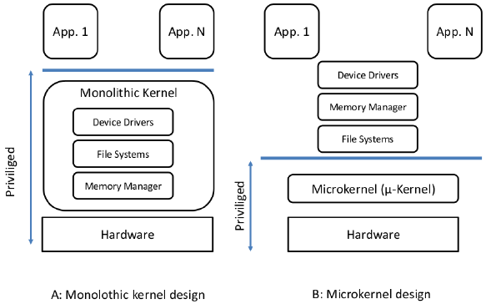

Slide 8
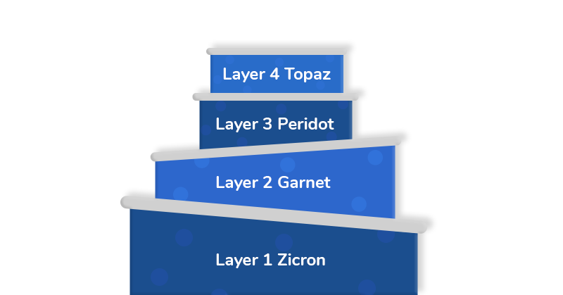
THE FOUR LAYERS OF FUCHSIA:

Slide 9
FIRST LAYER – ZIRCON
Zircon is the first layer and the foundation of Fuchsia OS.
Zircon is composed of a microkernel (source in kernel/…) as well as a small set of user space services, drivers, and libraries (source in system/…) necessary for the system to boot, talk to hardware, load user space processes and run them, etc.

Slide 10
SECOND LAYER – GARNET
Garnet is responsible for managing all the things that an OS requires such as device drivers, software installation, network, etc.
The different elements available at this layer are –
Escher - is a graphics renderer.
Amber -– an update system which will update all the components including the apps, kernel, and the bootloader.
Xi Core - It is the underlying engine for the Xi text and code editor. It is a modern text editor for enhanced performance.

Slide 11
THIRD LAYER – PERIDOT
The next layer in Fuchsia OS is the Peridot and is responsible for handling the Fuchsia modular app design.
The different elements available at this layer are –
Agent – It is the component that works in the background and provides information to other components.
Module – These are the components that you can see, and each module is designed for a specific task.
Ledger - is a distributed storage system devised to manage all the information.
Maxwell – It is used to manage small programs called agents.

Slide 12
FOURTH LAYER – TOPAZ
It is the top layer of Fuchsia OS and provides support for Flutter. All the apps we use every day will be included in the layer.

Slide 13
LANGUAGES AND FRAMEWORKS USED
Languages : Currently, Fuchsia Interface Definition Language(FIDL) supports five languages –
Dart
Go
C
C++
Rust
FRAMEWORKS : Flutter Framework

Slide 14
How is Flutter paving the way for Fuchsia?
Fast development
Expressive and flexible design
Native performance
The Flutter apps are written in Dart Programming Language.

Slide 15
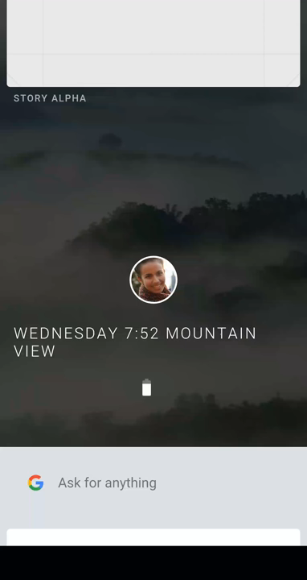
THE UI OF FUCHSIA:

Slide 16
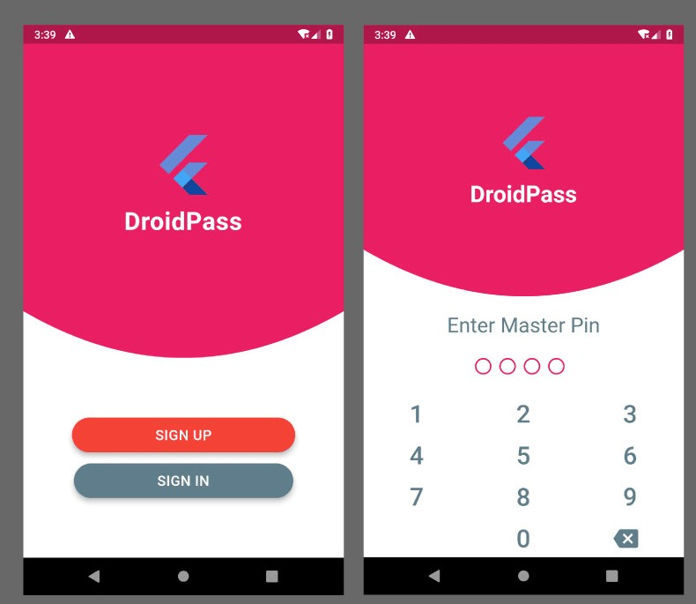
SIMPLE FLUTTER APP UI :

Slide 17
THE NEED OF FUCHSIA:
Scalability
Security
Light weight

Slide 18
THANKS & ANY QUERIES ?

